Slide 1
NUMBER SYSTEMS
CLASS IX SESSION – 6

Slide 2
Laws of Exponents for Real Numbers
Now, watch this video for better understanding.
https://www.youtube.com/watch?v=H90ZBlHVPV8

Slide 3

Let us discuss few examples for the same.
EXAMPLES : Simplify -
$3^{1/4}×3^{3/4}$ = ${3 }^{\frac{1}{4} + \frac{3}{4}}$ =$3^{1}$ = 3
2. $\frac{{5 }^{1/2}}{{5 }^{1/4}}$ = ${5 }^{\frac{1}{2} − \frac{1}{4}}$ = $5^{1/4}$
3. ${3 }^{3/2}$$×$${7 }^{3/2}$ = $( {3 ×7 )}^{3/2}$ = $( {21 )}^{3/2}$
4. $( {36 )}^{1/2}$ = $6^{2 × \frac{1}{2}}$ = $6^{1}$ = 6
5. $({81 )}^{− 1/4}$ = $\frac{1}{{(81)}^{1/4}}$ = $\frac{1}{{( 3^{4})}^{1/4}}$ = $\frac{1}{3}$

Slide 4
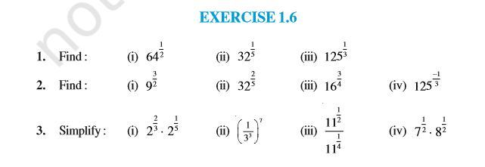
Now, do all questions of Exercise 1.6 .

Slide 5
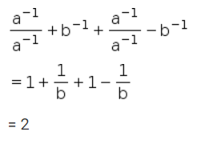
Let us discuss few more examples.
1. Simplify:
Solution.

Slide 6
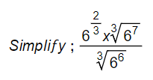
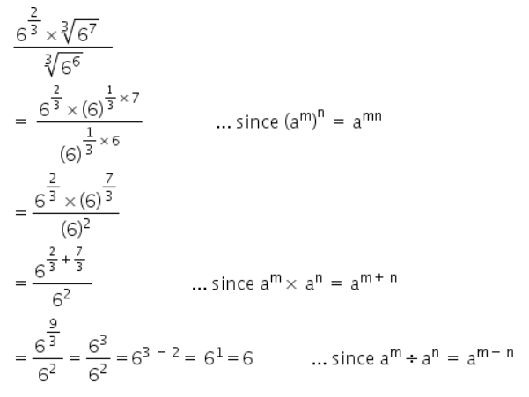
2.
Solution.

Slide 7
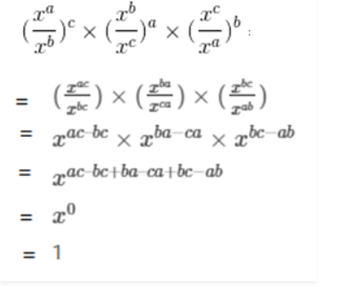
3. Prove that :
Solution:
LHS =
RHS = 1
Since , LHS = RHS
Hence Proved.

Slide 8
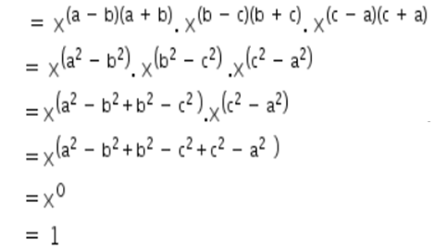
4.
Solution:
LHS =
RHS = 1
Since , LHS = RHS
Hence Proved.

Slide 9
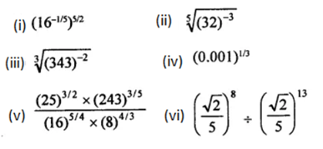
PRACTICE QUESTIONS:
1. Simplify:
2.

